Slide 1



Game Analysis Using SQL
SQL Queries

Slide 2
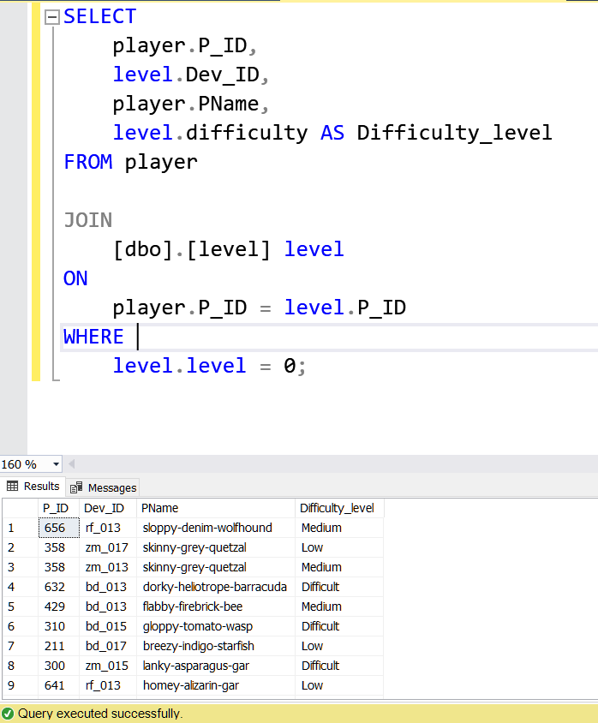
Question 1: Players at Level 0
Objective: Retrieve player details including player ID, device ID, player name, and difficulty level for players at Level 0.
The query focuses on extracting pertinent player information at the initial game level."

Slide 3
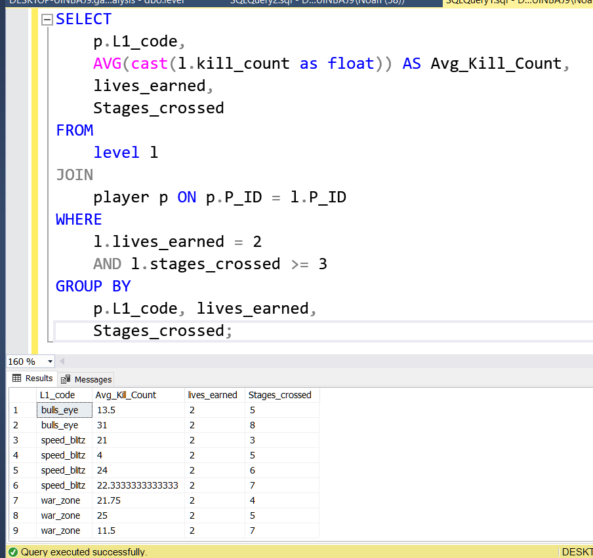
Question 2: Average Kill Count by Level1 Code
Objective: Determine the average kill count for each Level1 code, considering scenarios where players earn 2 lives and cross at least 3 stages.
The query calculates the Level1 code-wise average kill count based on specified gameplay conditions.

Slide 4
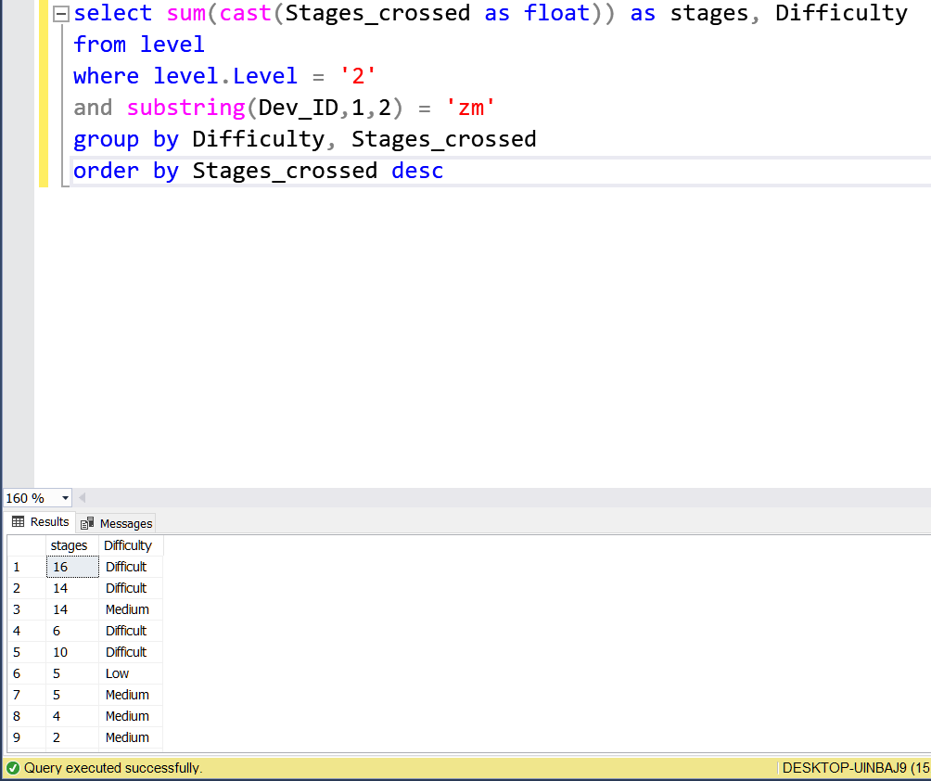
Question 3: Total Stages Crossed by Difficulty Level (Level 2, zm_series Devices)
Objective: Calculate the total number of stages crossed at each difficulty level for Level 2 gameplay sessions involving zm_series devices.
The query analyzes player progress based on device type and game level, focusing on identifying stages crossed across different difficulty levels.

Slide 5
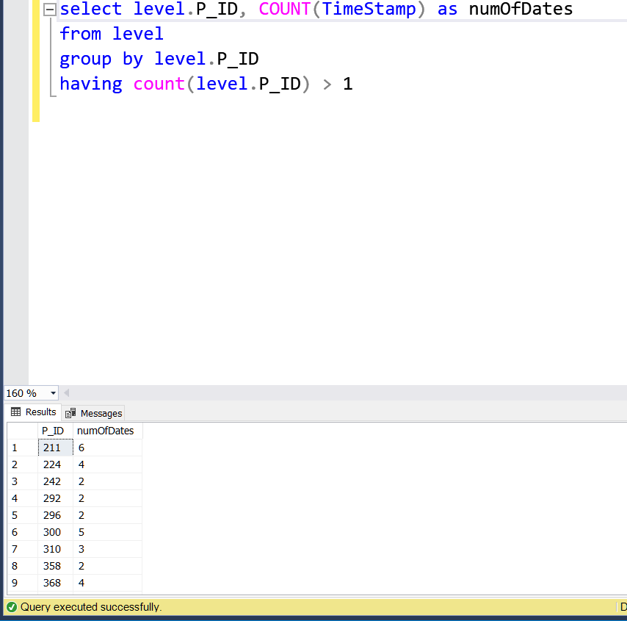
Question 4: Players with Multiple-day Gameplay
Objective: Identify players who have participated in gameplay sessions on multiple days and calculate the total number of unique dates.
The query focuses on extracting player IDs and counting the unique dates to assess multi-day player engagement.

Slide 6
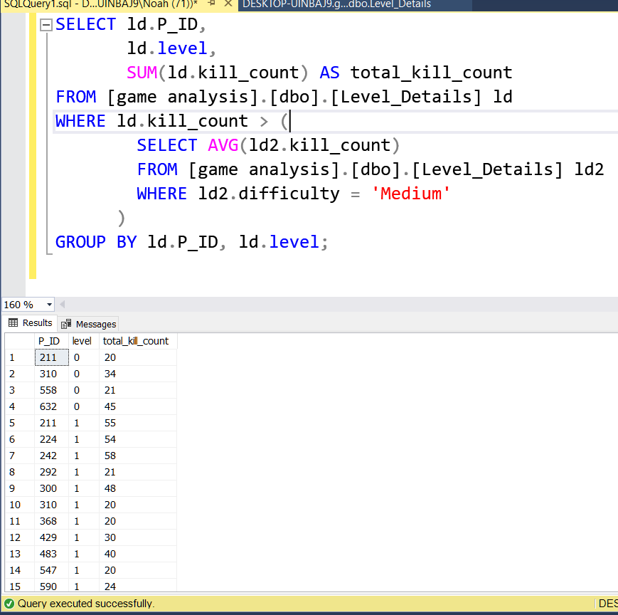
Question 5: Player ID and Level-wise Sum of Kill Counts
Objective: Determine player IDs and the total kill counts for each level where the kill count exceeds the average for Medium difficulty.
The query extracts player IDs and their corresponding kill counts, focusing on levels where the kill count surpasses the average for Medium difficulty.

Slide 7
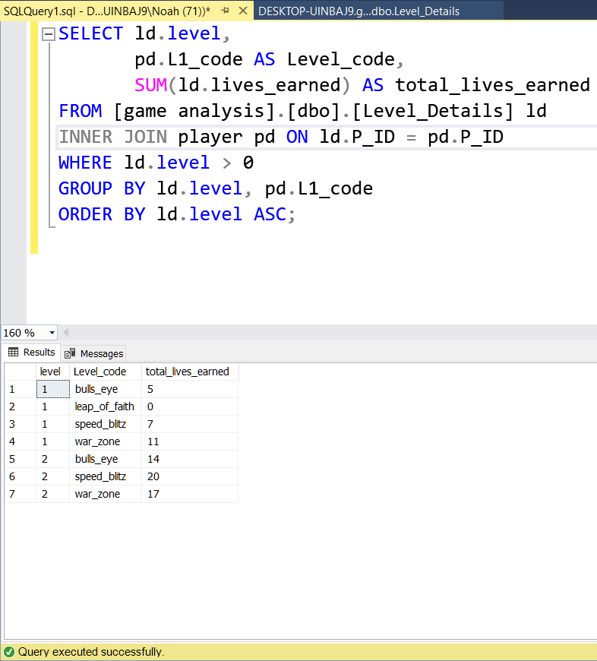
Question 6: Total Lives Earned by Level (Excluding Level 0)
Objective: Calculate the total number of lives earned for each level, excluding Level 0, and organize the results in ascending order of level.
"The query focuses on aggregating lives earned data based on game levels, excluding the initial level, to assess player progression.

Slide 8
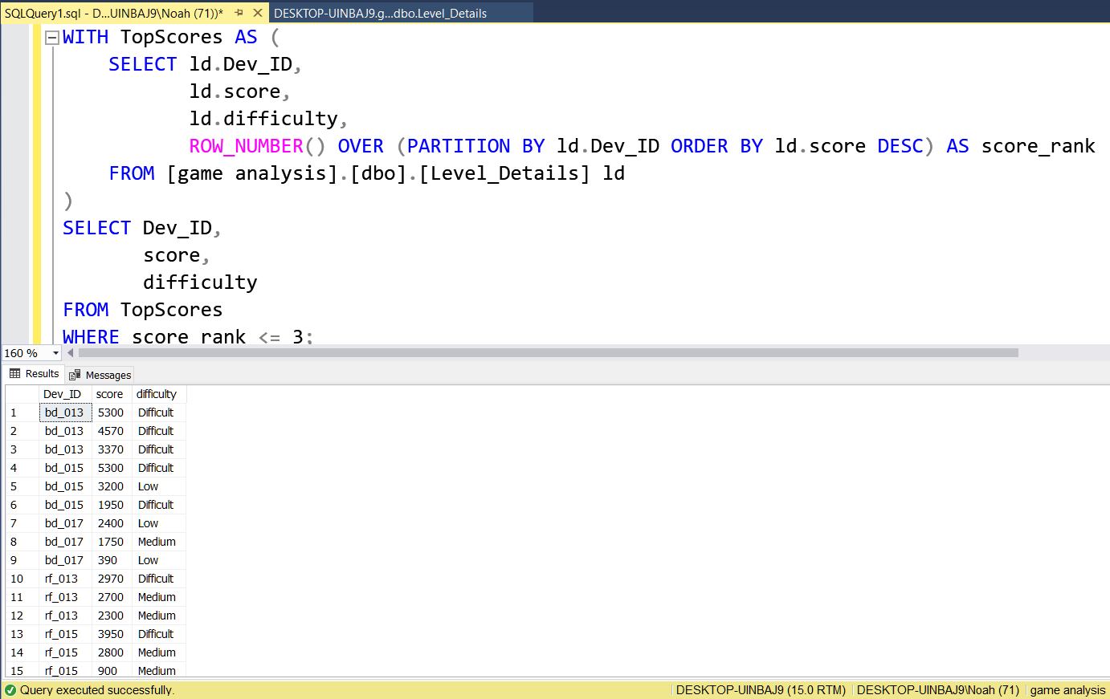
Question 7: Top 3 Scores by Device ID
Objective: Identify the top 3 scores for each device ID, ranked in increasing order.
The query aims to provide insights into the highest scoring players within each device ID category, along with their associated difficulty levels.

Slide 9
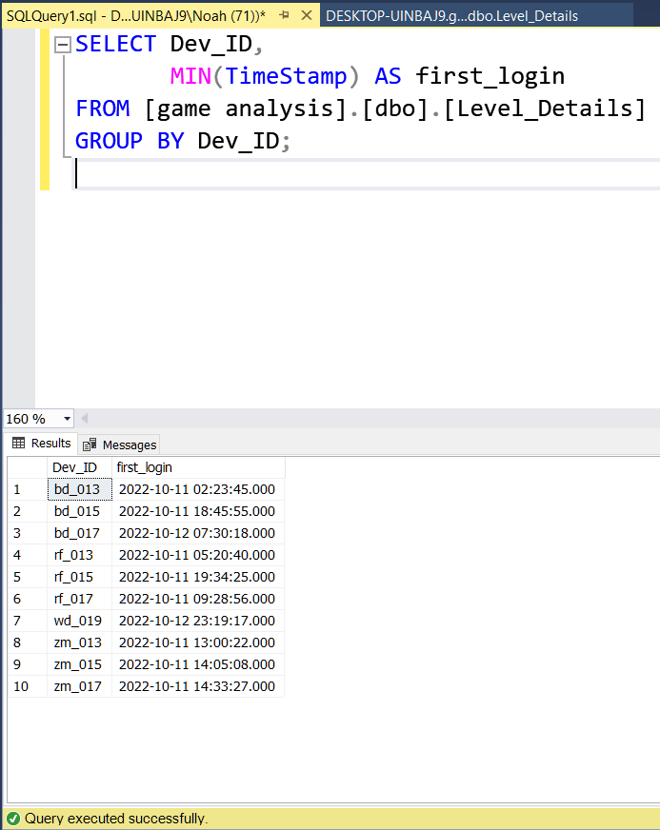
Question 8: First Login Datetime by Device ID
Objective: Determine the datetime of the first login for each device ID.
The query aims to extract the initial login datetime for each unique device ID, providing insights into the earliest usage of each device.

Slide 10
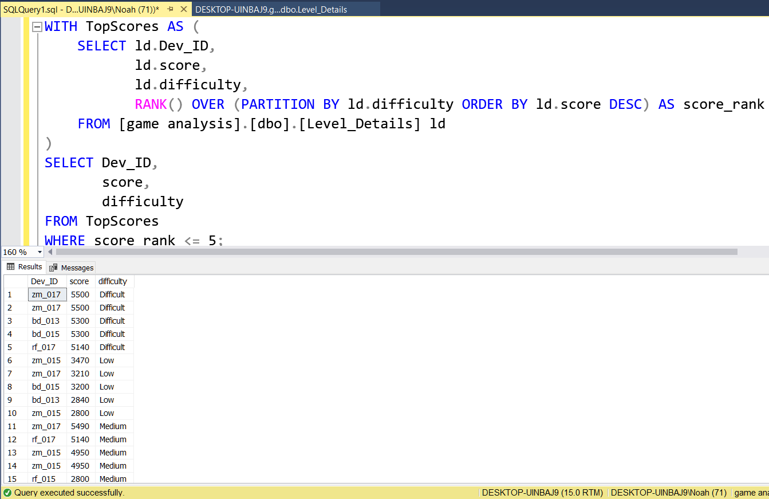
Question 9: Top 5 Scores by Difficulty Level
Objective: Identify the top 5 scores for each difficulty level, ranked in increasing order.
The query aims to provide insights into the highest scoring players within each difficulty level, along with their associated device IDs.

Slide 11
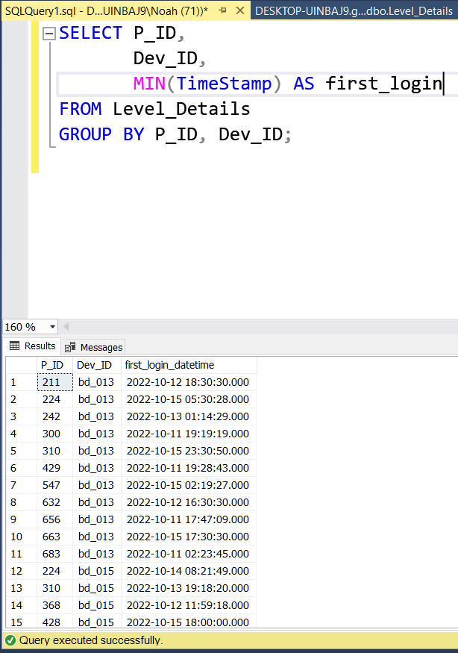
Question 10: First Login Device ID for Each Player
Objective: Determine the device ID that each player first logged in with, along with the corresponding datetime of the first login.
"The query aims to identify the initial login device for each player, providing insights into player onboarding and usage patterns.

Slide 12
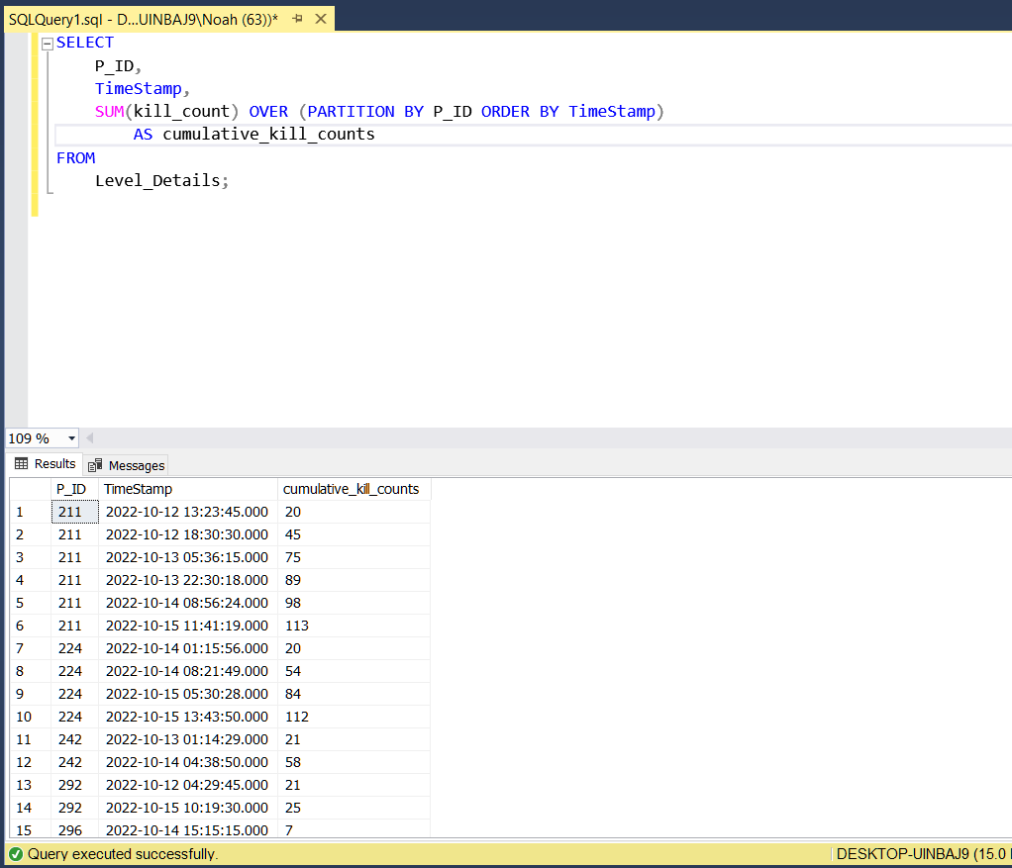
Cumulative Kill Counts by Player and Date (Using Window Functions)
Objective: Calculate the cumulative number of kill counts played by each player up to each date using window functions.
"This method utilizes SQL window functions to efficiently compute cumulative values

Slide 13
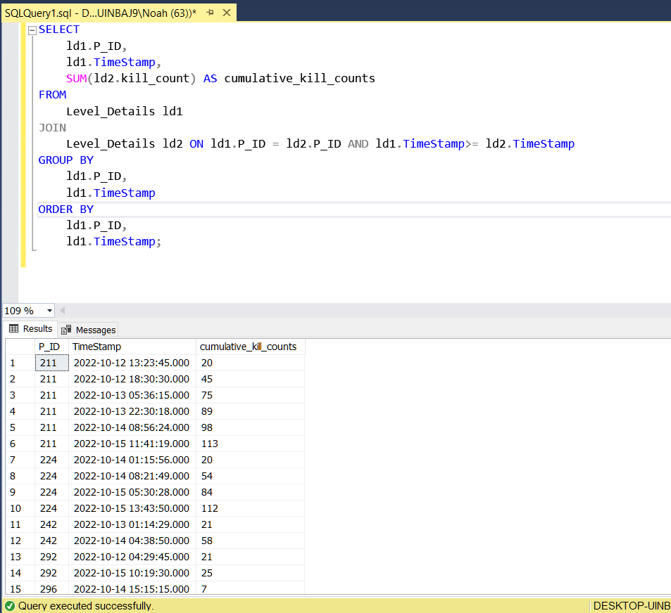
Cumulative Kill Counts by Player and Date (Without Window Functions)
Objective: Calculate the cumulative number of kill counts played by each player up to each date without using window functions.
This method employs subqueries or joins to aggregate kill counts iteratively.

Slide 14
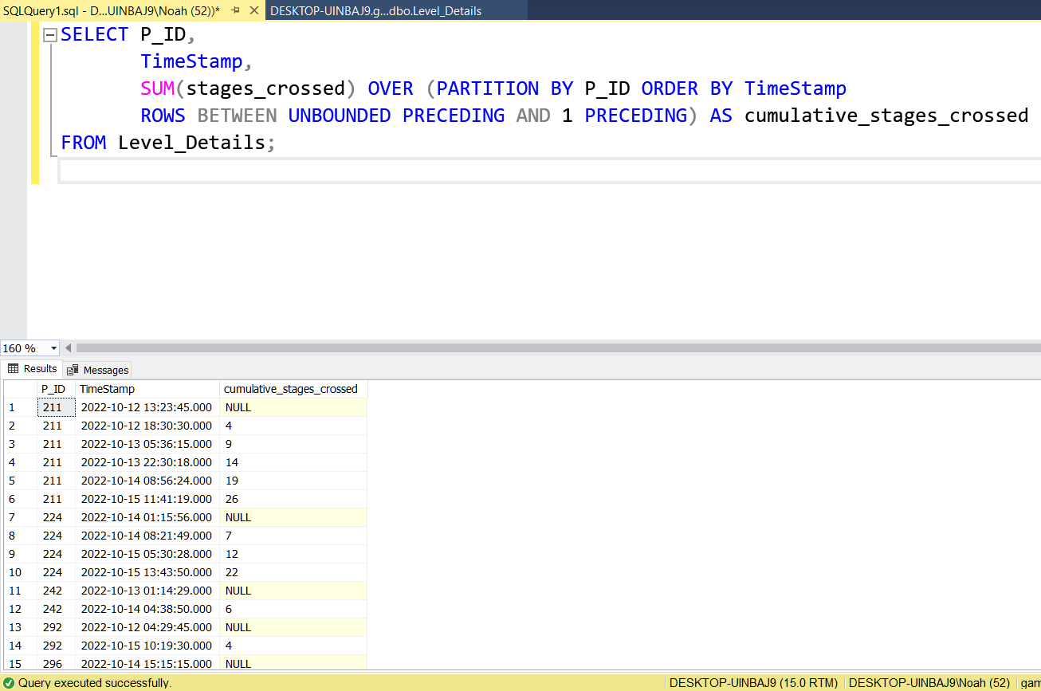
Cumulative Sum of Stages Crossed Over (Excluding Most Recent (start_datetime) by Player ID
Objective: Calculate the cumulative sum of stages crossed over start_datetime for each player ID, excluding the most recent start_datetime.
This query aims to analyze player progression by aggregating stages crossed over time, excluding the latest session.

Slide 15
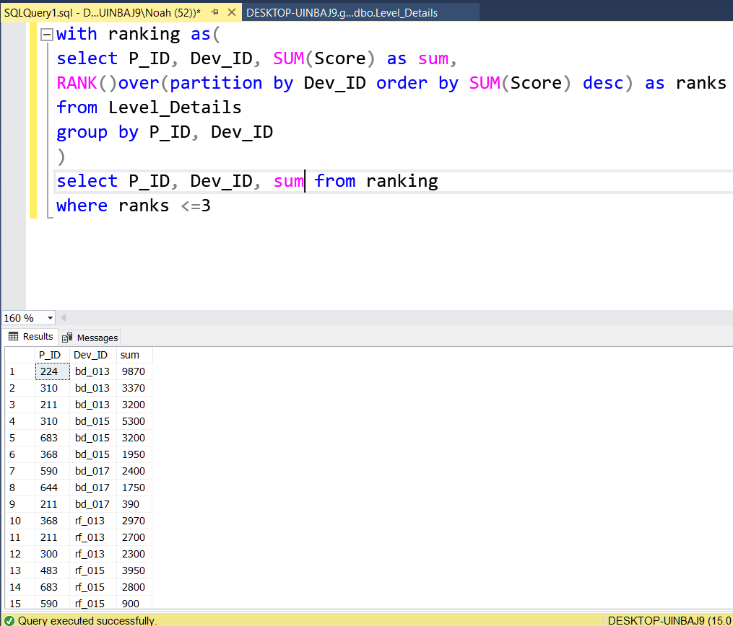
Top 3 Highest Sums of Scores by Device ID and Corresponding Player ID
Objective: Extract the top 3 highest sums of scores for each device ID and the corresponding player ID.
This query aims to identify the top-scoring players for each device ID, providing insights into player performance.

Slide 16
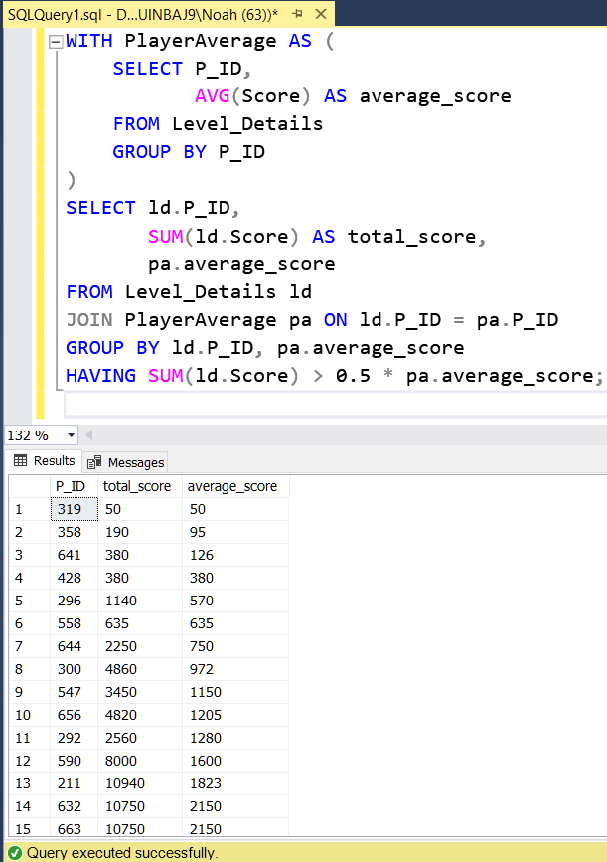
Players Scoring Above 50% of Average Score by Player ID
Objective: Identify players who scored more than 50% of the average score, calculated by the sum of scores for each player ID.
This query aims to highlight players who achieved significant scores relative to the average.

Slide 17
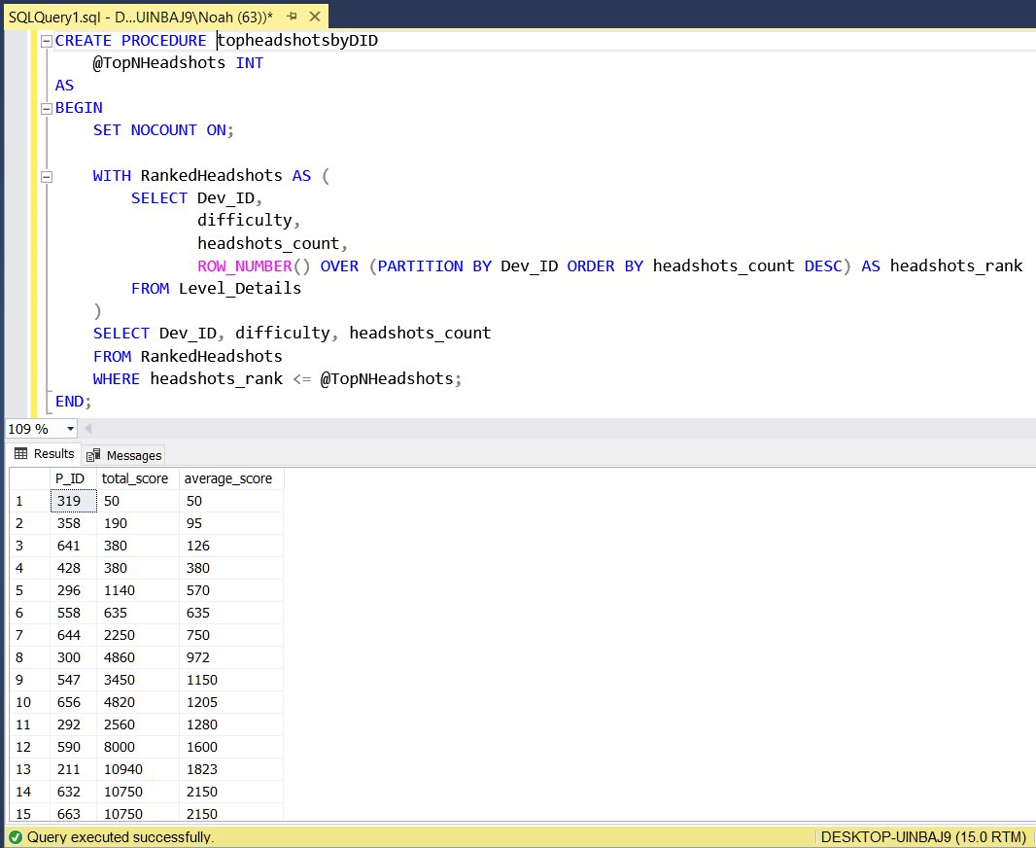
Stored Procedure for Finding Top n Headshots Count by Device ID and Ranking
Objective: Create a stored procedure to find the top n headshots count based on each device ID and rank them in increasing order using Row_Number."
"This stored procedure aims to automate the process of identifying top headshots counts for each device ID, providing insights into player performance

Slide 18
Thanks
Mahmoud Mustafa

